Slide 1
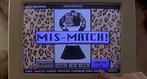
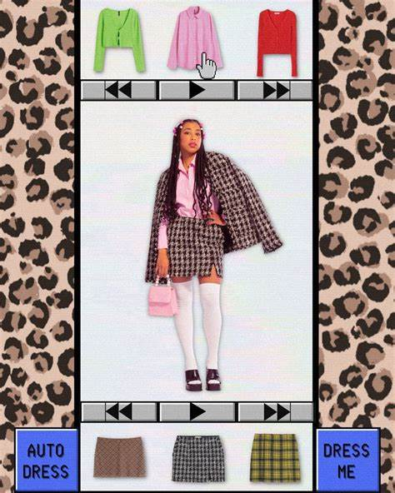
Clothing Generator
Your Day.
Your Weather.
Your look.
Brittney Hayes
This is a clothing generator that allows you to pick your outfits based off of the weather and event you have planned for the day.

